Slide 1


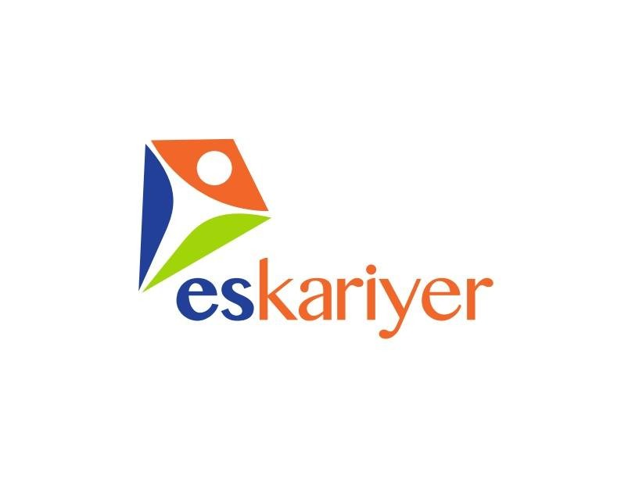

Innovation Hackathon 2021
https://istanbul.impacthub.net/innovation-hackathon/
Challenge 2: Es Kariyer
http://erisilebilircv.com/
We believe in NO obstacles

Slide 2
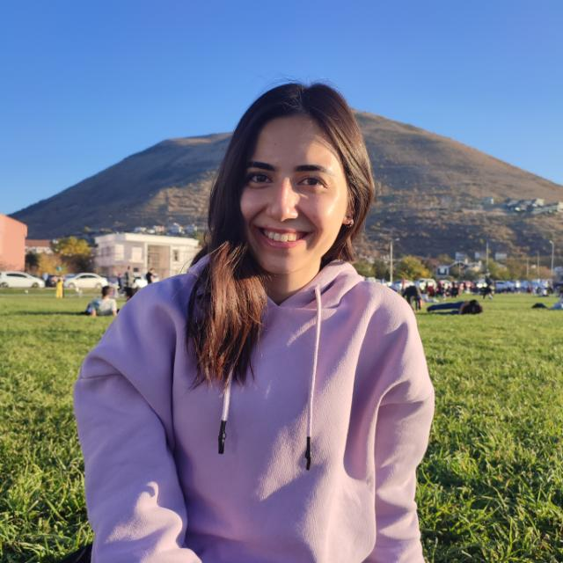
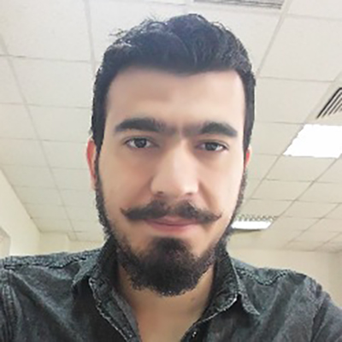
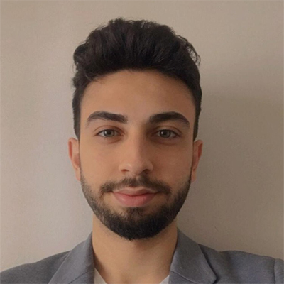
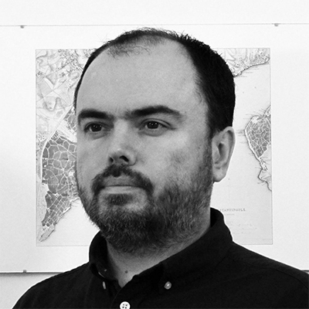
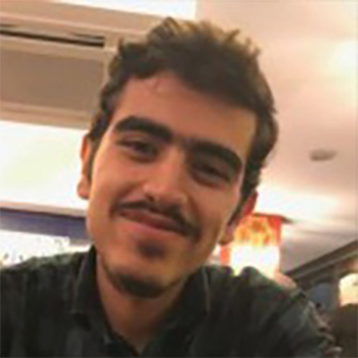
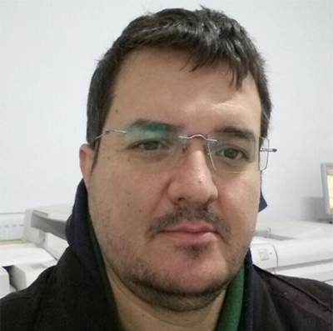
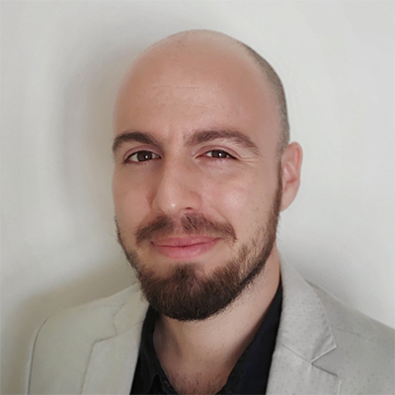

TEAM MEMBERS / 7 Members (3 student, 2 intern/jobseeker, 2 academician)
Beste Erol
Aviation Electrical And Electronics
Erciyes University
Mehmet Salih Güneş
Aviation Electrical And Electronics
Erciyes University
Mustafa Yağız Atlı
Aviation Electrical And Electronics
Erciyes University
Ömer Devrim Aksoyak
Assistant Prof. Dr.
Abdullah Gul University
Özgür Aksu
Research Assistant
Erciyes University
Ufuk Deniz Demirbilek
Electrical Engineer
İstanbul Technical University
Ömer Faruk Bahar
Computer Engineering
Marmara University
1/10

Slide 3

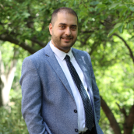
TEAM ADVISOR
Assit. Prof. Dr. Mehmet Emin Öztürk
Department of Special Education
Erciyes University
Advise area(s); Most topic’s are required from persons for better choose for target employment in people with disabilities. Area’s, required field’s and terminology support is very suitable for project. Thanks to Dr. Mehmet Emin ÖZTÜRK for volunteering support.
1/10

Slide 4

WHAT WE WANT
«Erişilebilir CV» aims to create more and sustainable employment opportunities for people with disabilities;
According to recent studies, approximately 13% of Turkey’s population have various kinds of disabilities and approximately 22% of them can work actively. That means only 2 million people with disabilities can work. In this context, our priority is to ensure that suitable candidates are placed in appropriate positions, after carefully interviewing the candidates and conducting behavioral analyses to ensure that this active workforce is used correctly. We use and develop a system in order to provide equal opportunities for candidates who were eliminated due to prejudices. Also, we aim to stop eliminating the individuals just because they were 'disabled' without knowing their exact disability status, and for them to work in the right jobs.
2/10

Slide 5
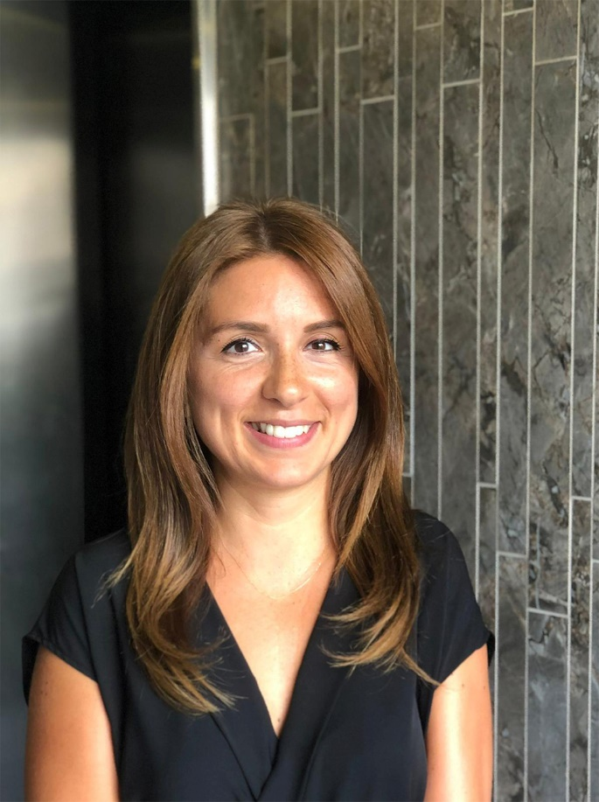
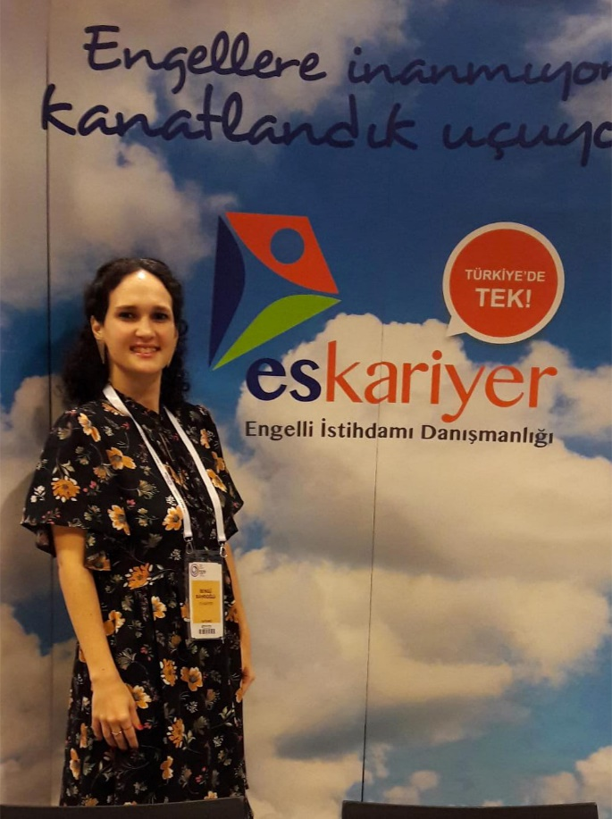

ES KARIYER
Es Kariyer Company aims to create more and sustainable employment opportunities for people with disabilities. According to recent studies, approximately 13% of Turkey’s population have disabilities and approximately 22% of them can work actively. Therefore, only 2 million people with disabilities can work. In this context, our priority is to ensure that suitable candidates are placed in appropriate positions, after carefully interviewing the candidates and conducting behavioral analyses to ensure that this active workforce is used correctly. You can click here to find a video for a short explanation of the issue.
Esra Odabaşı
Founder
ES Kariyer
Bengü Bahrioğlu
Expert
ES Kariyer
https://eskariyer.com/
3/10

Slide 6
Project Outcomes for evalution; DEMO PAGE / Github CODE PAGE
DEMO ONLINE TOOL / WEB PAGE
http://erisilebilircv.com/
Github CODE PAGE
https://github.com/InnovationHackathon-istanbul-2021/es-kariyer-challenge
3/10

Slide 7
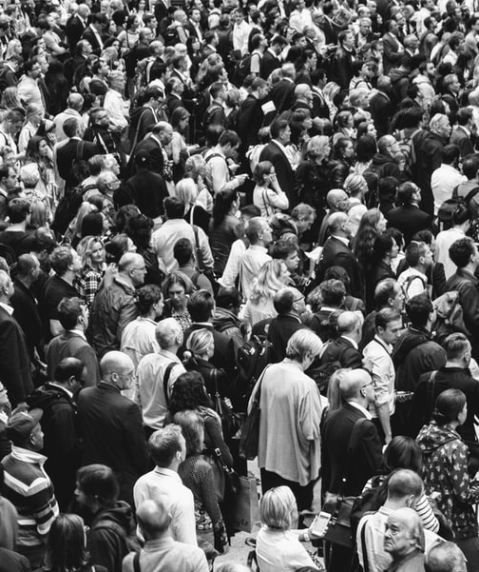
CHALLENGE
Approximately 10 million people, 13% of the population of Turkey have disabilies. Only 21% of this population can be included in the workforce. The unemployment rate for these people is about 22% and they mainly reside in Istanbul.
People with disabilities cannot fully take part in business life and are exposed to disabilities that affect their lives.
4/10

Slide 8

THE EFFECT ON THE SOCIAL ENTERPRISE
We are planning to design a feedback system that can be used by the members using the site in the content of the site we will establish to check whether our solution works. In the content of the feedback system, there will be questions in survey format about how much the site serves its purpose of establishment.
In addition, it is aimed that the tool developed within the scope of the project will support the sustainable employment of more disabled individuals within the scope of the target problem and solution tree. In addition to all these, with the project, it will be possible to bring the disabled but qualified human labor force, which is idle to the national economy, to the working life and the economy as a tax contribution. It will be ensured that more individuals can be a positive example, not consuming, but producing.
5/10

Slide 9

THE EFFECT ON THE SOLUTION
In the system we designed, we will design a system according to the scenario 'How might we support the automatic transfer of candidate CVs from Kariyer to our own online platform to reduce workload?'. In the system we will design, the OCR (Optical Character Recognition) method will be used. Regardless of the file format of the CVs uploaded to the site by our members, we will analyze the articles in the CVs by considering all of them as if they are picture files(like whatsupp picture etc.). We will provide the members with the appropriate job position by making sense of the analyzed articles.
6/10

Slide 10

FEASIBILITY OF THE SOLUTION
Let's take a look at the technical benefits of the system:
The crowd of file format types in the database will be reduced
Instead of examining the content of CVs by individuals, with the designed system, more suitable job position matching can be made for users with less mistakes.
Significant time savings.
7/10

Slide 11

UNIQUENESS OF THE IDEA
With this system that we designed, which is unique in Turkey, we interview people who want to benefit from our service, unlike other sites, at the stage of membership opening, by our human resources team. We create a member account for individuals based on the interview results obtained. Afterwards, we include the CVs requested from them in the OCR system coded by our technical team. Regardless of the file type format of the CVs, we consider all of the CVs in image file format, making sense of the texts in the OCR system and matching them with the most suitable job position for the person.
8/10

Slide 12

THE FINANCIAL SUSTAINABILITY
In order for our system to be financially sustainable in the long and short term, advertisements should be placed on certain parts of the site we will establish and a certain amount of dues should be collected from companies that need a person with disability.
9/10

Slide 13

CONCLUSION
The goal that our project is trying to achieve in general;
Breaking the prejudice against the people with disabilities
Conveying accurate information about the people with disabilities
Preventing discription specifically blocking people's disabilities
Increasing employment opportunities for the people with disabilities
We plan to achieve these goals by offering the Erişilebilir CV platform to people. In this regard, a consensus has been formed with our solution partners on employment for individuals with disabilities.
If this project is realized, we expect that it will create a multiplier effect on the employment of people with disabilities by eliminating the domino effect for the families and environment of the people, and it will have an employment-increasing effect in the long run.
10/10

Slide 14
thank you for listening to us
http://erisilebilircv.com/
We believe in NO obstacles
Innovation Hackathon 2021 operates within the framework of the ‘PEP-Promotion of Economic Prospects’ programme which is financed by the German Federal Ministry for Economic Cooperation and Development (BMZ) and implemented by the Deutsche Gesellschaft für Internationale Zusammenarbeit (GIZ) in cooperation with Re:Coded & Impact Hub.

